Slide 1

Neural Networks in Practice: Mini-Batches
Presented by:
Elizer Ponio Jr.
Department of Computer Science
College of Computing and Information Technologies

Slide 2
Outline
Review of Gradient Descent
Stochastic Gradient Descent
Mini-Batch Gradient Descent

Slide 3
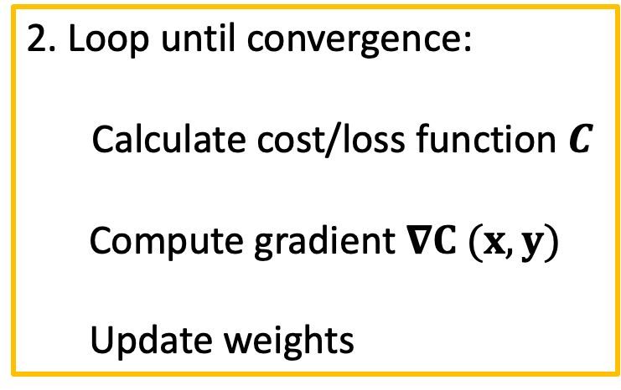
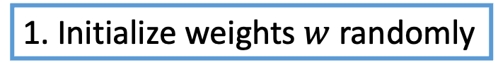
Review of Gradient Descent
1. Initialize weights $w$ randomly
2. Loop until convergence:
Calculate cost/loss function $C$
Compute gradient $∇C (x, y)$
Update weights
3. Return weights

Slide 4




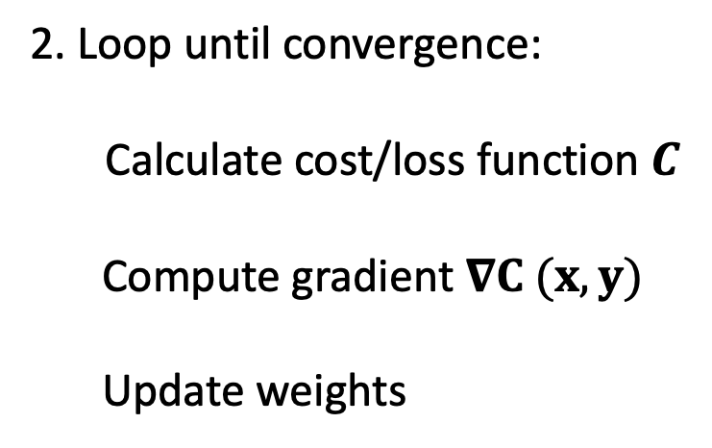


Review of Gradient Descent
1. Initialize weights $w$ randomly
2. Loop until convergence:
Calculate cost/loss function $C$
Compute gradient $∇C (x, y)$
Update weights
$$w_{1}$$
$$w_{2}$$
$$w_{3}$$
$$0.5$$
$$1.5$$
$$0.7$$
3. Return weights

Slide 5

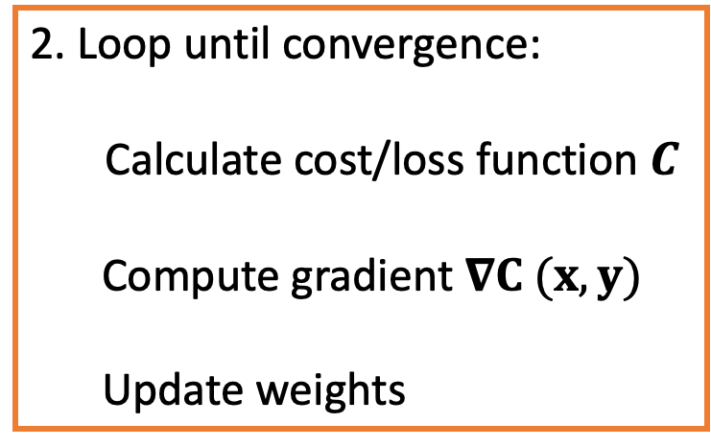
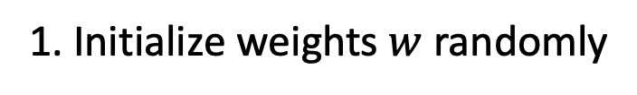
Review of Gradient Descent
1. Initialize weights $w$ randomly
$$C (x,y)$$
2. Loop until convergence:
Calculate cost/loss function $C$
Compute gradient $∇C (x, y)$
Update weights
3. Return weights

Slide 6
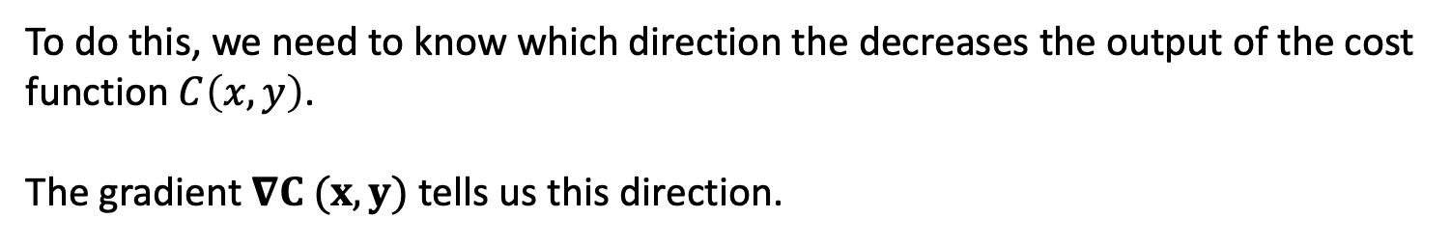
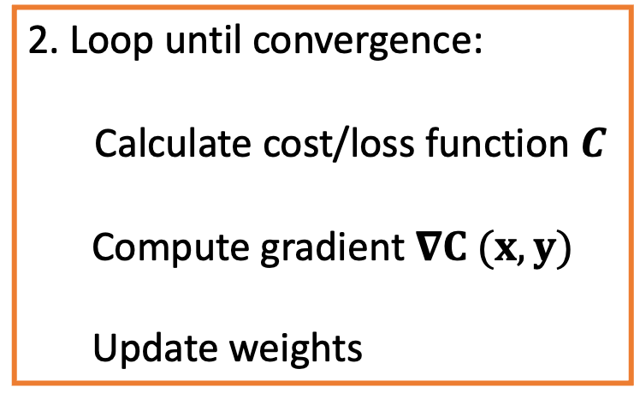

2. Loop until convergence:
Calculate cost/loss function $C$
Compute gradient $∇C (x, y)$
Update weights
The object of this step is to find the value of weights so that the loss/cost $C\left(x,y\right)$ is minimized.
To do this, we need to know which direction the decreases the output of the cost function$C\left(x,y\right)$.
The gradient $∇C (x, y)$ tells us this direction.

Slide 7



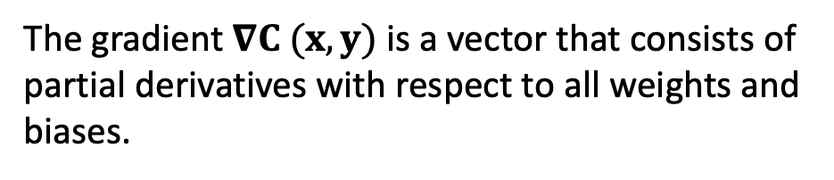


2. Loop until convergence:
Calculate cost/loss function $C$
Compute gradient $∇C (x, y)$
Update weights
$$\frac{∂C}{∂w_{1}}$$
$$\frac{∂C}{∂b_{1}}$$
$$∇C=$$
.
.
.
$$\frac{∂C}{∂w_{i}}$$
The gradient $∇C (x, y)$ is a vector that consists of partial derivatives with respect to all weights and biases.
$$\frac{∂C}{∂b_{i}}$$

Slide 8
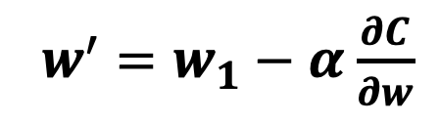
2. Loop until convergence:
Calculate cost/loss function $C$
Compute gradient $∇C (x, y)$
Update weights
Once we know the gradient, we update the weight using the formula
$w^{′}=w_{1}−α$ $\frac{∂C}{∂w}$
Where $α$ is the learning rate which is a hyperparameter that determines the step size

Slide 9



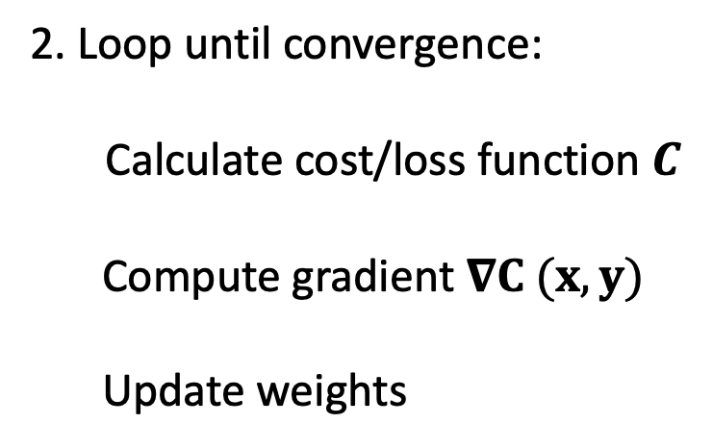
Review of Gradient Descent
1. Initialize weights $w$ randomly
2. Loop until convergence:
Calculate cost/loss function $C$
Compute gradient $∇C (x, y)$
Update weights
$$1.2$$
$$5.5$$
$$0.9$$
3. Return weights

Slide 10
Stochastic Gradient Descent
1. Initialize weights $w$ randomly
2. Loop until convergence:
Calculate cost/loss function $C$
Compute gradient $∇C (x, y)$
Update weights
3. Return weights

